Slide 1

Data Lake Value Proposition
Medical Data Processing Company
Daniel Pazeto Júnior
Udacity IPS Version 1.0

Slide 2
Agenda
What is a Data Lake
Components of a Data Lake
Data Lake vs Data Warehouse
Business Value of Data Lake Solution
Proposed Data Lake Architecture for Medical Data Processing system
Udacity IPS Ver. 1 2/2020

Slide 3
What is a Data Lake
Executive summary
Contains all the company data to serve analysts and tools
Should support petabytes of data
Contains structured and non-structured data
Data Lake is divided in layers:
Ingestion
Storage
Processing
Serving

Slide 4
Components of Data Lake
4 Layers
Ingestion
Set of tools responsible to collect the data from different sources
Storage
Set of tools reponsible to storage, backup, versioning and secure all the collected and transformed data
Processing
Set of tools reponsible to get all collected data and perform the needed transformations and anonymization
Serving
Set of tools reponsible to serve the data for all the stakeholders, dashboards and every who want/allowed to see the data.
Notes:
< Think About: What elements are needed to make a data lake? What different layers and/or tools involved? Identify at least 3 in your high level list here. Elaborate more on each component in video.>

Slide 5
Data Lake vs Data Warehouse
Notes:
< Think about: Research if a Data Warehouse can still be a viable solution instead of a Data Lake? What is the difference between both? >
< You will complete this information on the next slide. Please provide at least 3 items for each. No need to add any content on this slide >
< Video tip: While presenting the differences, elaborate why a Data Lake solution makes more sense for Medical Data Processing Company over a Data Warehouse approach? How the Data Lake / Big Data characteristics different from Data warehouse>

Slide 6
Data Warehouse
Data Lake
More aggregated data
Less storage size
More structured data
Quickier queries
Used by mainly business analysts
Used for historical analytics, visualizations, BI
Rawer data
More storage size
Less aggregated data
Slower queries
Use by data scientists and data developers, business analysts
Used for predictive analytics, machine learning
Udacity IPS Ver. 1 2/2020

Slide 7
Business Value of Data Lake
Single source of truth
Data available for everyone and everytime
Data Analysts or everyone can access and play with data, extracting insights and values to help the company on
Know better the business and customers
Be ahead of the competitors
Continues business evolving due to the knowledge that come from data
Put closer different areas of the company avoiding the silos
Saving Money and/or discovering a way to earn more
Notes:
< Think about: Provide an executive level summary based on your analysis of problem statement. How would implementing a Data Lake solution help Medical Data Processing Company? Please identify at least 3 business outcomes of building a Data Lake?>
<Video tip: Explain “Why” Data Lake solution makes sense for Medical Data Processing Company. >

Slide 8
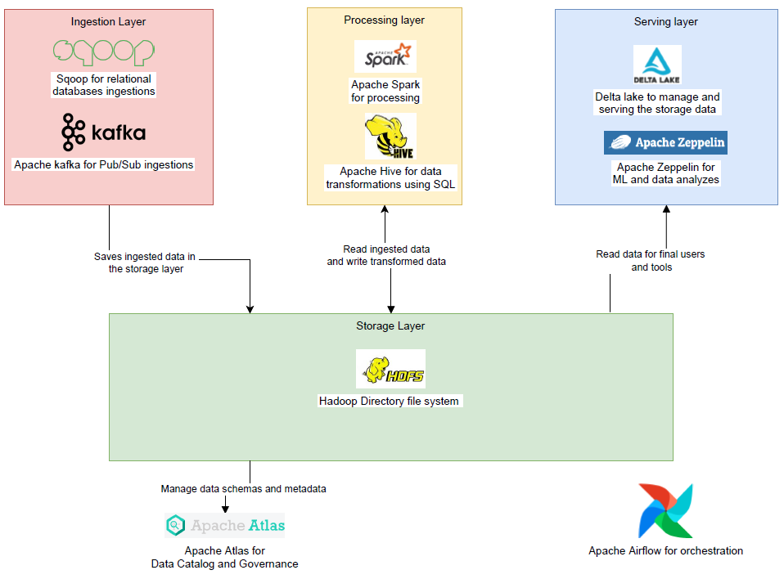
Data Lake Architecture

Slide 9
THANK YOU
Udacity IPS Version 1.0

